Slide 1
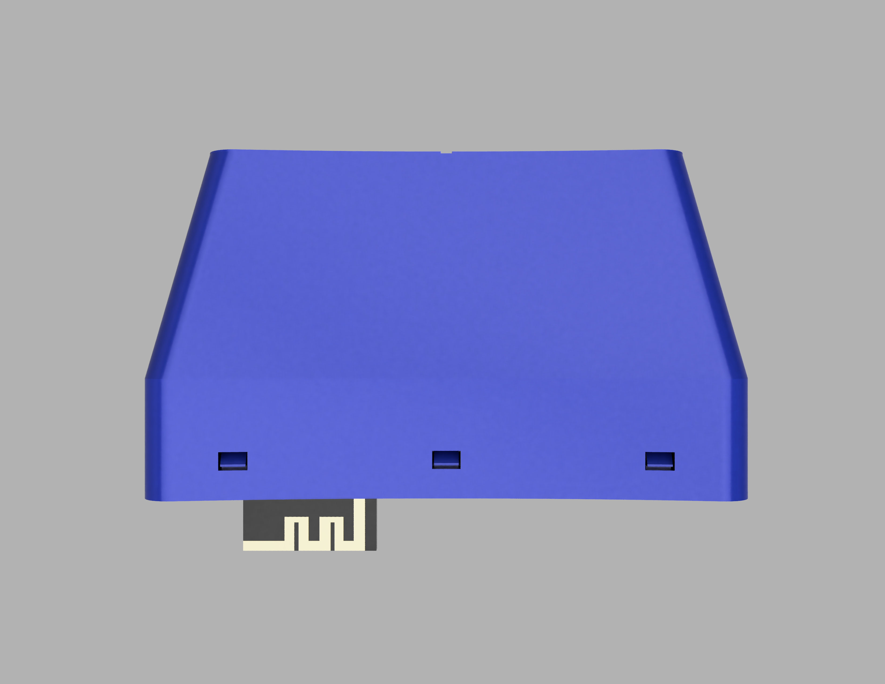
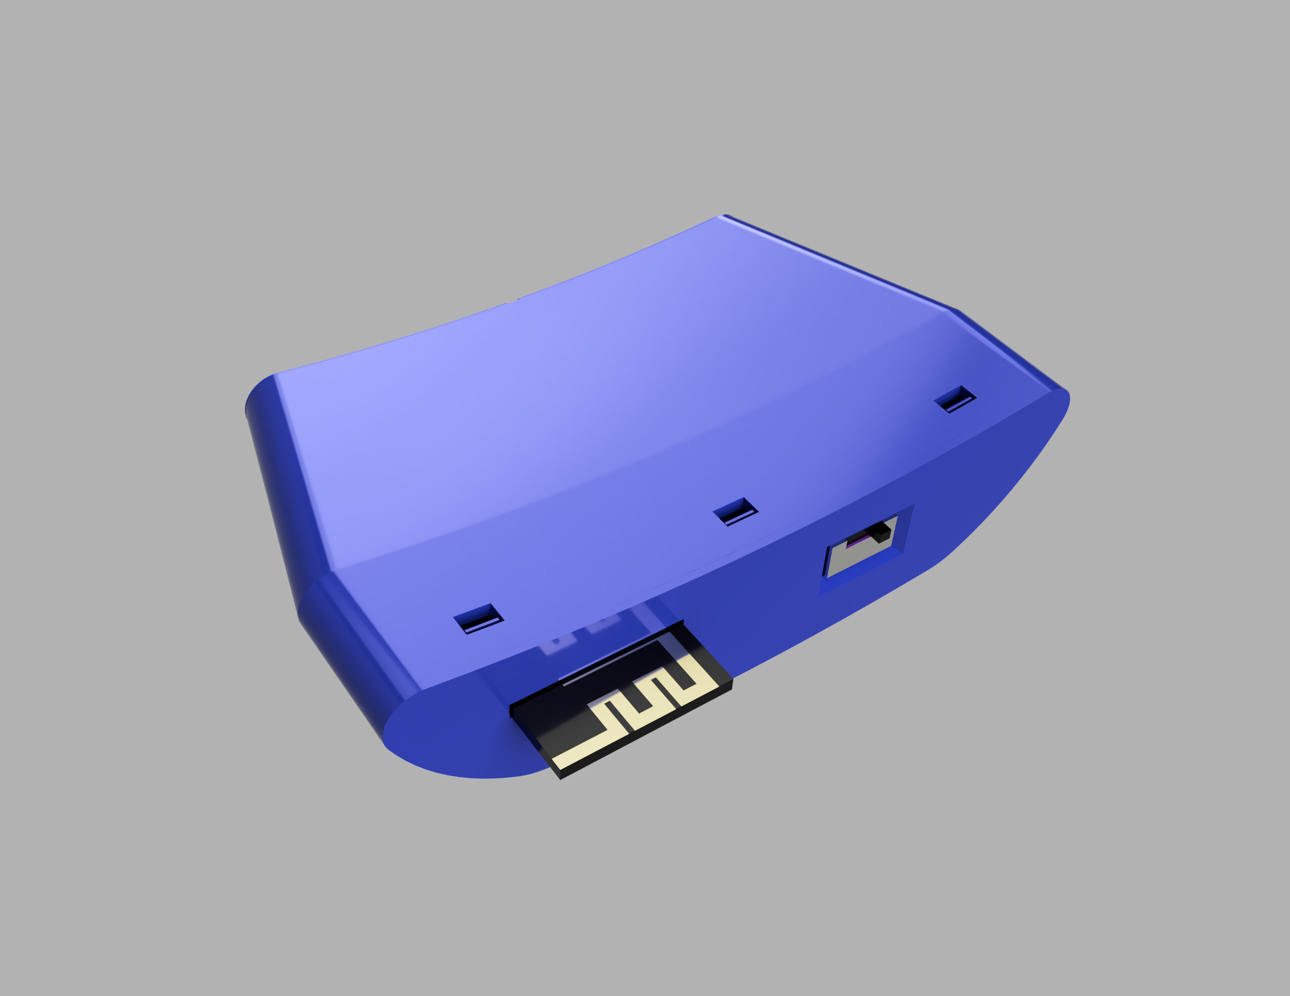
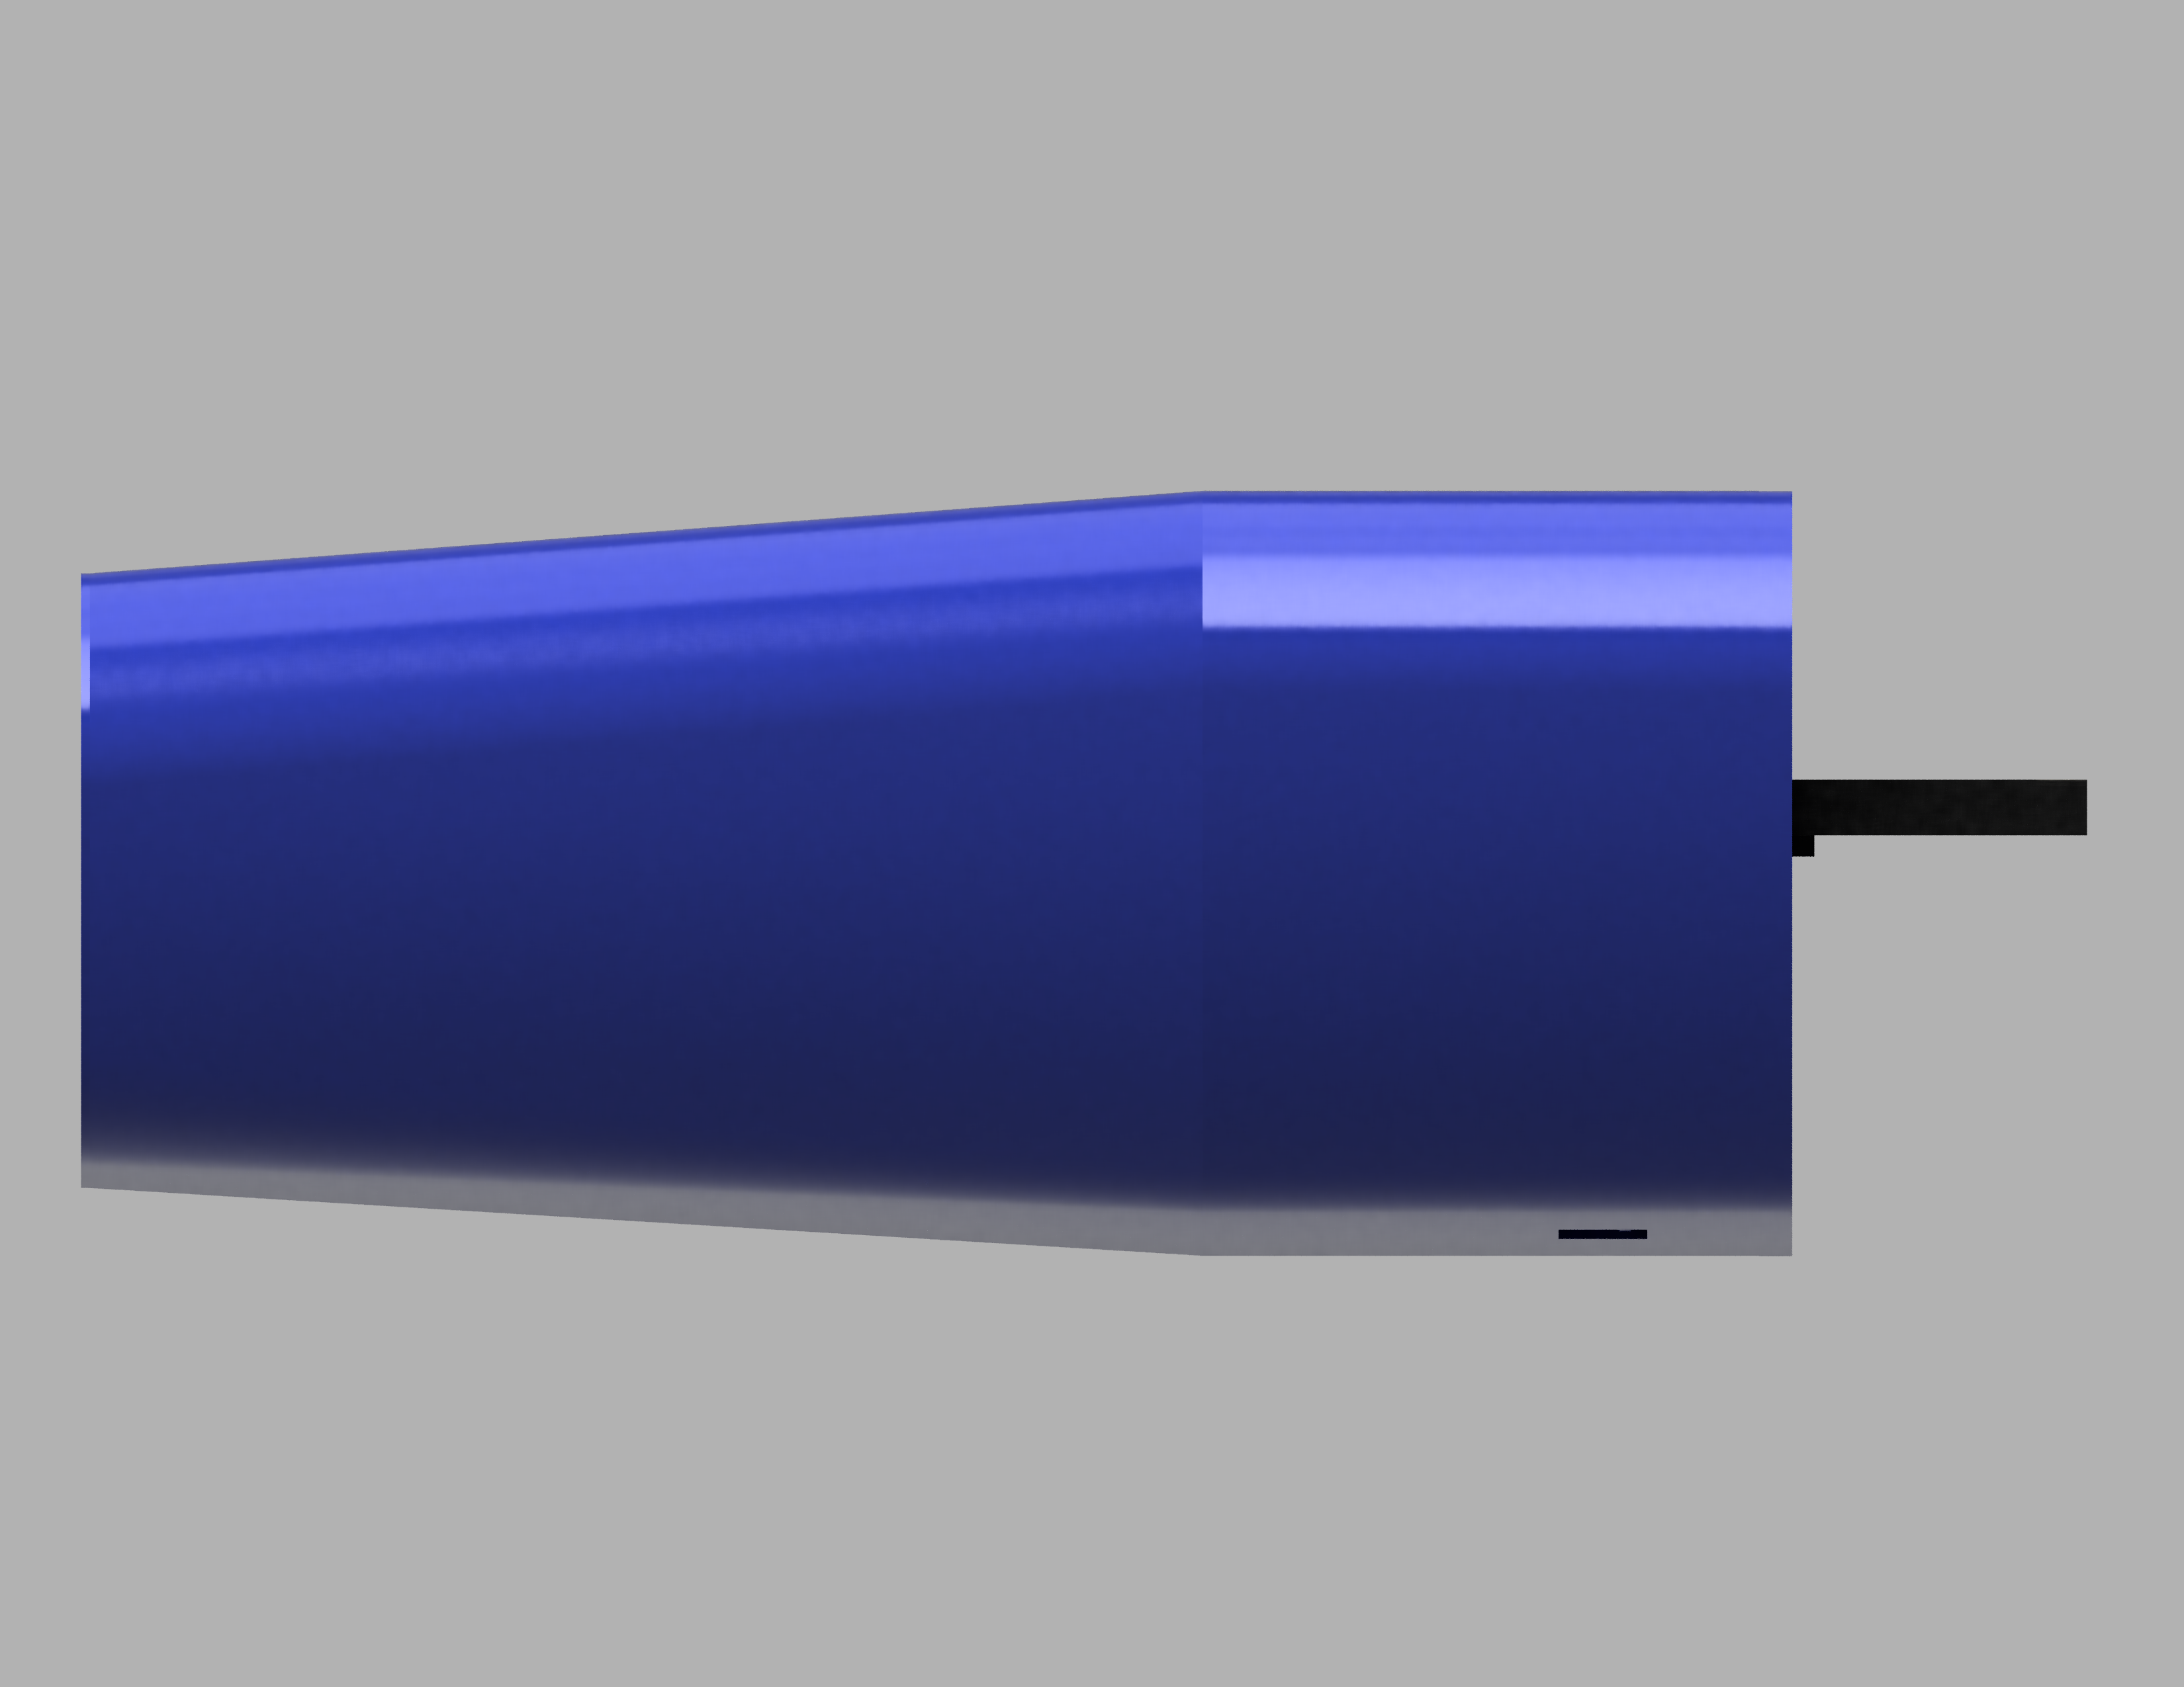
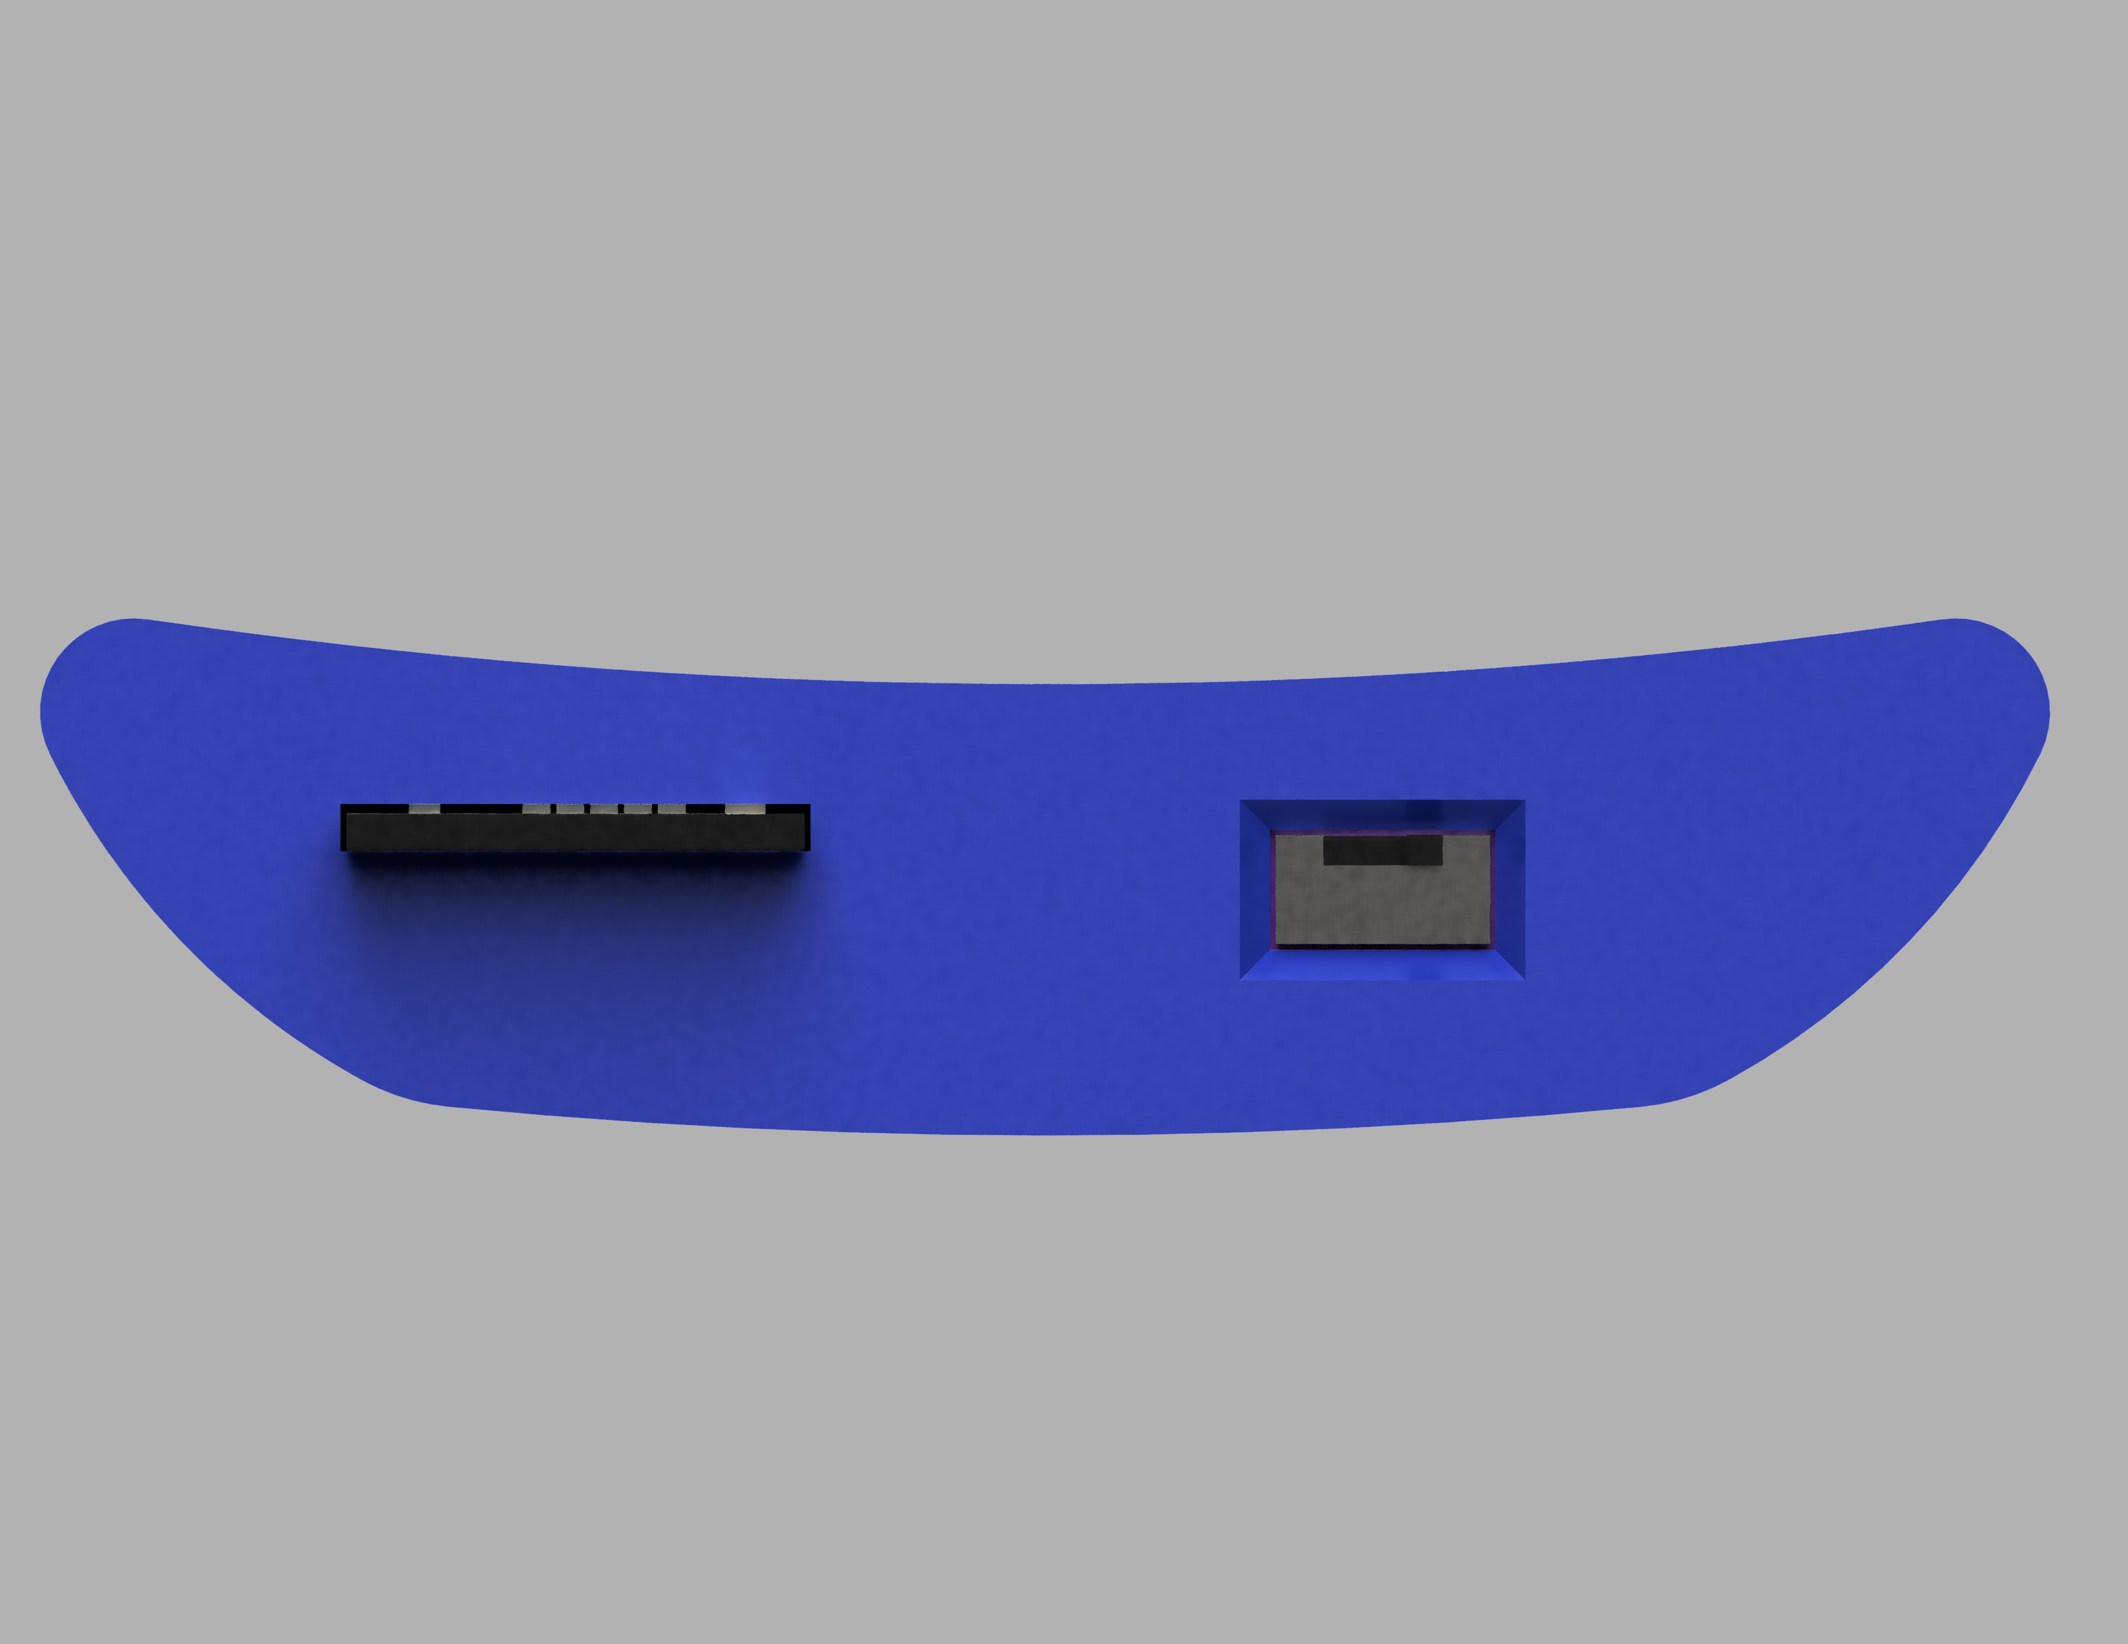

Slide 2


Slide 3


Slide 4


Slide 5

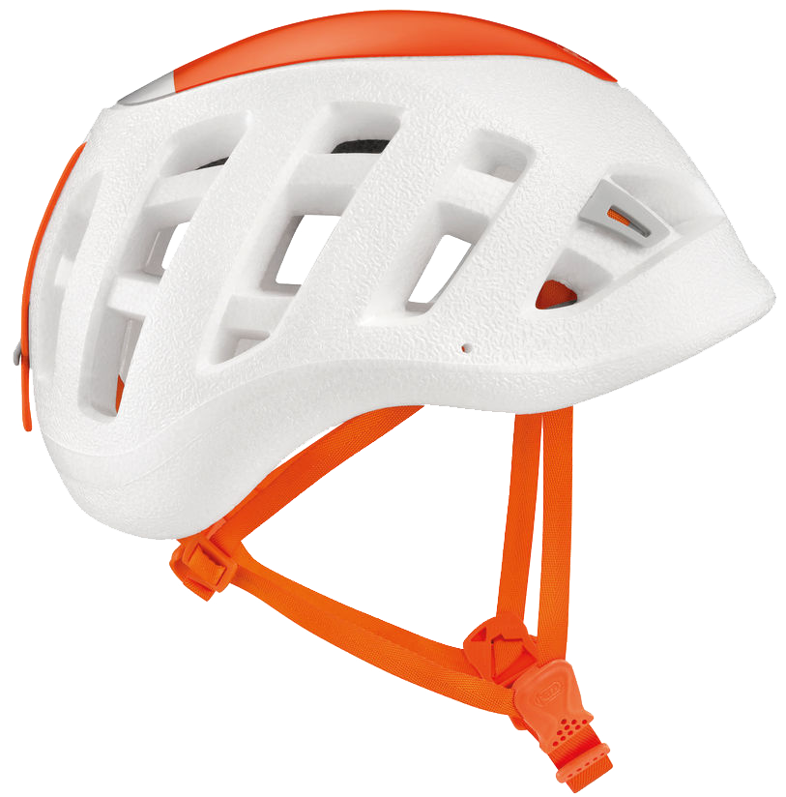

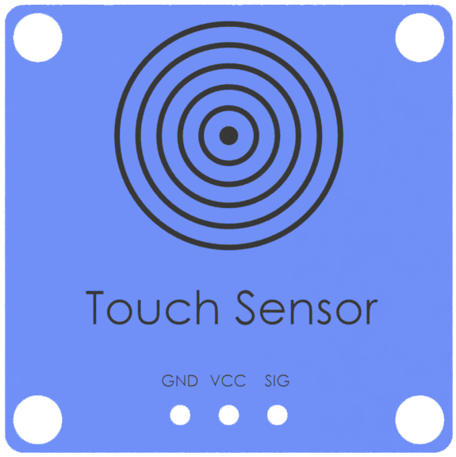
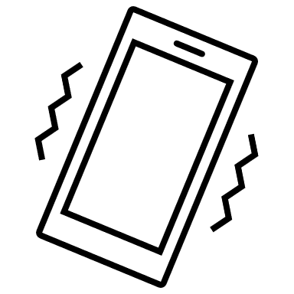
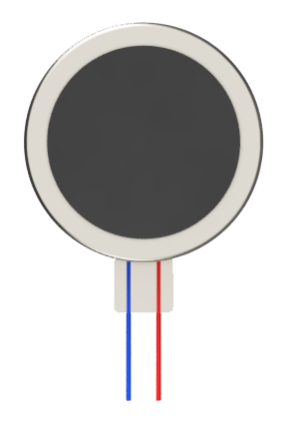


Slide 7


Slide 10


Slide 11
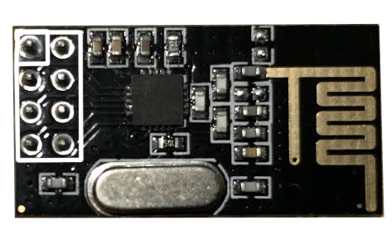
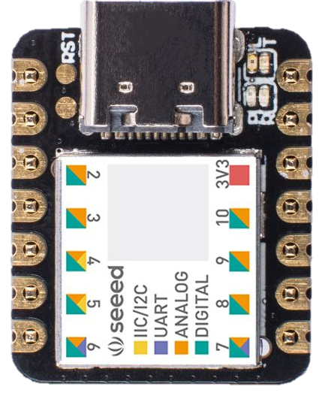
GND | VCC 3.3v
SPI CE | SPI CS
SCLK | MOSI
MISO | IRQ
Left Touch | 5v
Right Touch | GND
Left Vibrate | 3.3v
Right Vibrate | MOSI
SPI CE | MISO
SPI CS | SCK
_ | _

Slide 12
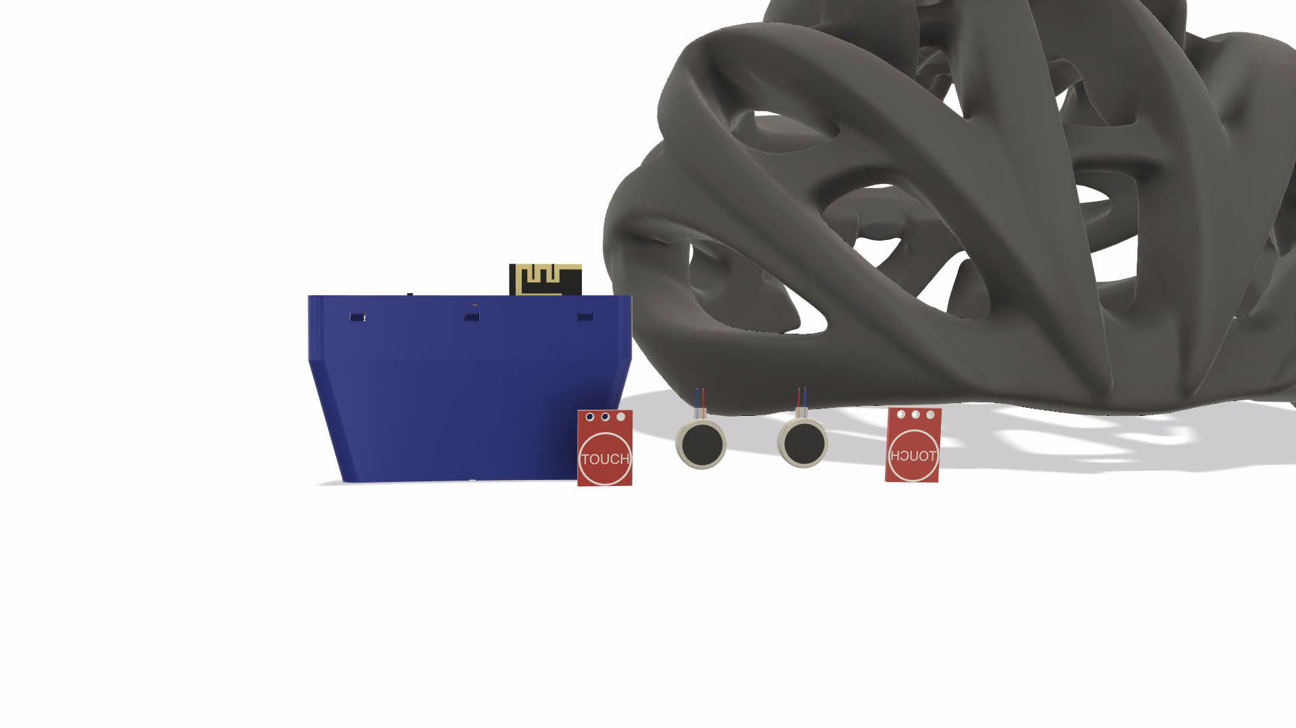
Compute Capsule
Exposed Antenna
Touch Sensor
Mini Vibrator
Your Favorite Helmet

Slide 13
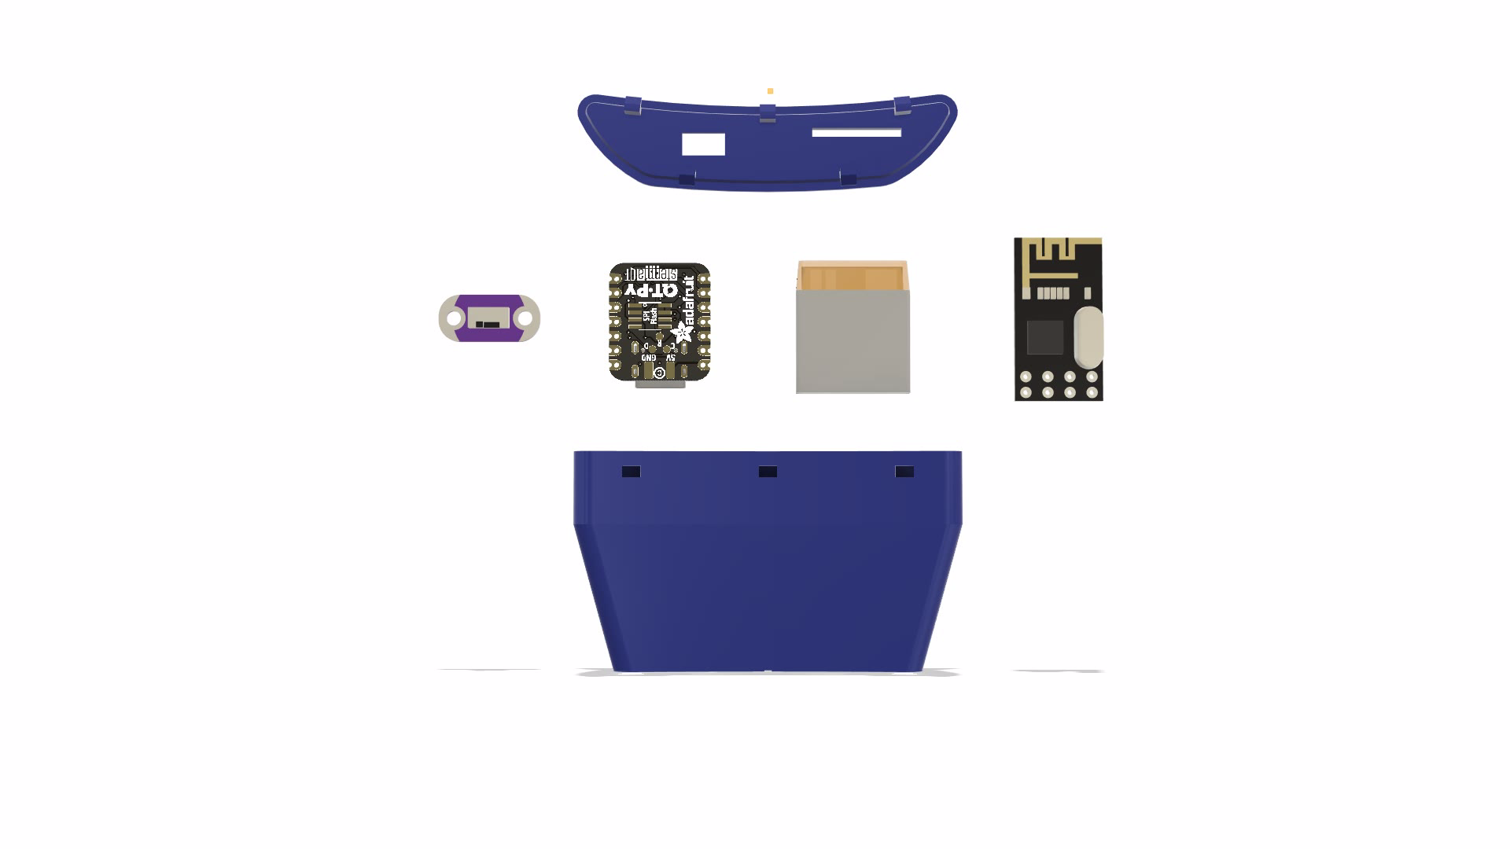
LiPo Battery
Battery Power Switch
QT Py Microcontroller
RF24+ Radio Module
3D Printed Case

Slide 14
